Slide 1




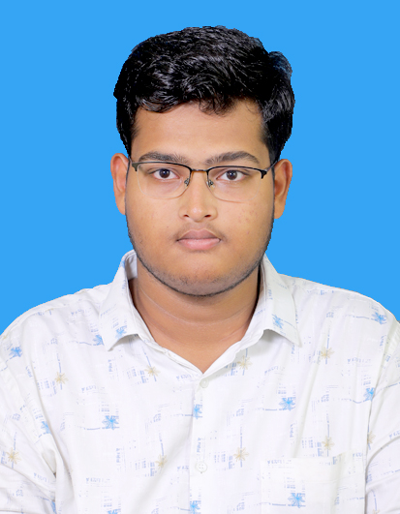

THE STUDENT PORTFOLIO
VELAGA SUBHASH
velagasubhash03@gmail.com
SRM UNIVERSITY AMARAVATI
ANDHARA PRADESH
FRONT END DEVOLOPMENT
03-06-2024 TO 27-07-2024
DGT

Slide 2
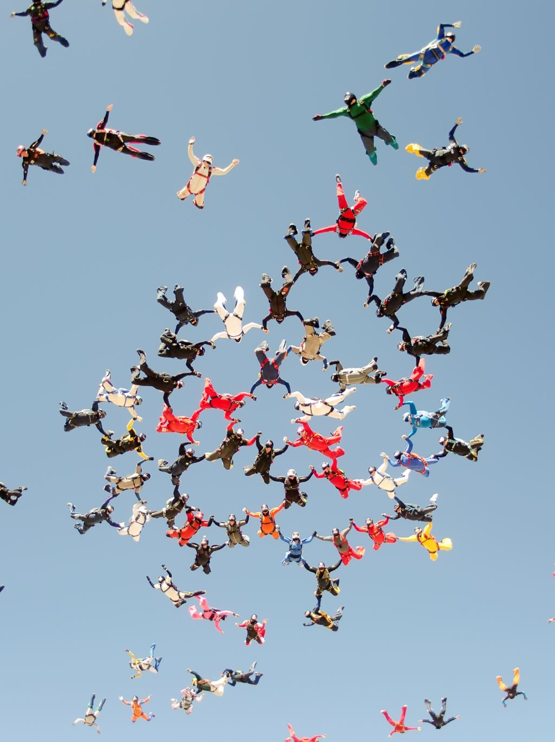
PROBLEM OF STATEMENT
Create a comprehensive digital student portfolio that highlights academic achievements, skills, extracurricular activities, and personal projects. This portfolio will provide a dynamic and engaging platform for students to present their work to colleges, employers, and other stakeholders. The goal is to offer a complete and attractive representation of the student's capabilities and accomplishments.

Slide 3
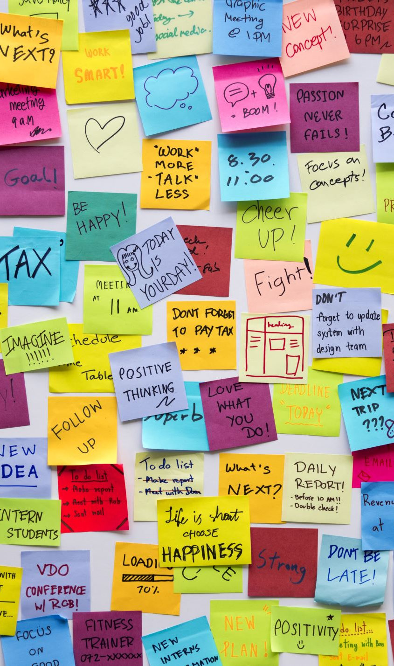
AGENDA
1. Introduction
Welcome and Overview
Purpose of the Project
2. Project Background
Initial Situation
Internship Opportunity
3. Methodology
Requirement Analysis
Design and Layout
Content Collection
Development (HTML, CSS, JavaScript)
4. Progress and Deliverables
Progress Till Date
7. Conclusion
Summary
8. Closing Remarks
Contact Information

Slide 4

PROJECT OVERVIEW
PROJECT TITLE
Student Portfolio
OBJECTIVE
A student portfolio project is designed to showcase a student's skills, accomplishments, and growth over time. It can be used for various purposes, including academic evaluations, college applications, job searches, and personal reflection.
KEY FEATURES
About Me
Skills
Projects
Education
Resume

Slide 5
END USER OF THIS PROJECT
Prospective Employers: They evaluate student portfolios to assess potential hires' skills, experiences, and suitability for job roles or internships.
01
Admissions Committees: They review portfolios to understand applicants' qualifications, projects, and overall fit for advanced educational programs or scholarships.
02
Peers and Classmates: They view each other’s work for inspiration, collaboration, and networking opportunities.
03

Slide 6

SOLUTION AND ITS VALUE PROPOSTION
A student portfolio website provides a centralized platform for students to showcase their achievements and skills, receive valuable feedback from educators and mentors, and connect with potential employers and educational opportunities, enhancing career prospects and personal development.

Slide 7

CUSTOMAIZATION OF PROJECT
1. Personalized Design
Colours : Selected a colours that with personality and professional style.
Profile Image: Incorporated a high-quality, professional image to personalize the website.
2. Content
Introduction Section: Creating a personalized introduction that highlights unique background, interests, and career goals.
Skills Section: Highlighted specific technical skills and soft skills that are most relevant to career aspirations in web development.
3. Project Descriptions
Detailed Project Descriptions: Each project includes a detailed description, personal reflections, and the specific role played. This provides context and highlights individual contributions.
Downloadable PDFs: Integrated downloadable PDFs of project reports, providing in-depth insights and demonstrating thorough documentation skills.
4. Education Section
Table Format: Presented educational background tabular format, including institutions, degrees, that showcases academics.
5. Interactive Elements
JavaScript Enhancements: Implemented interactive elements such as smooth scrolling, dynamic content displays, and form validations using JavaScript to create a modern and engaging user experience.
6. Resume Integration
Downloadable Resume: Provided an easily accessible, downloadable PDF resume, ensuring potential employers can quickly view his qualifications.

Slide 8
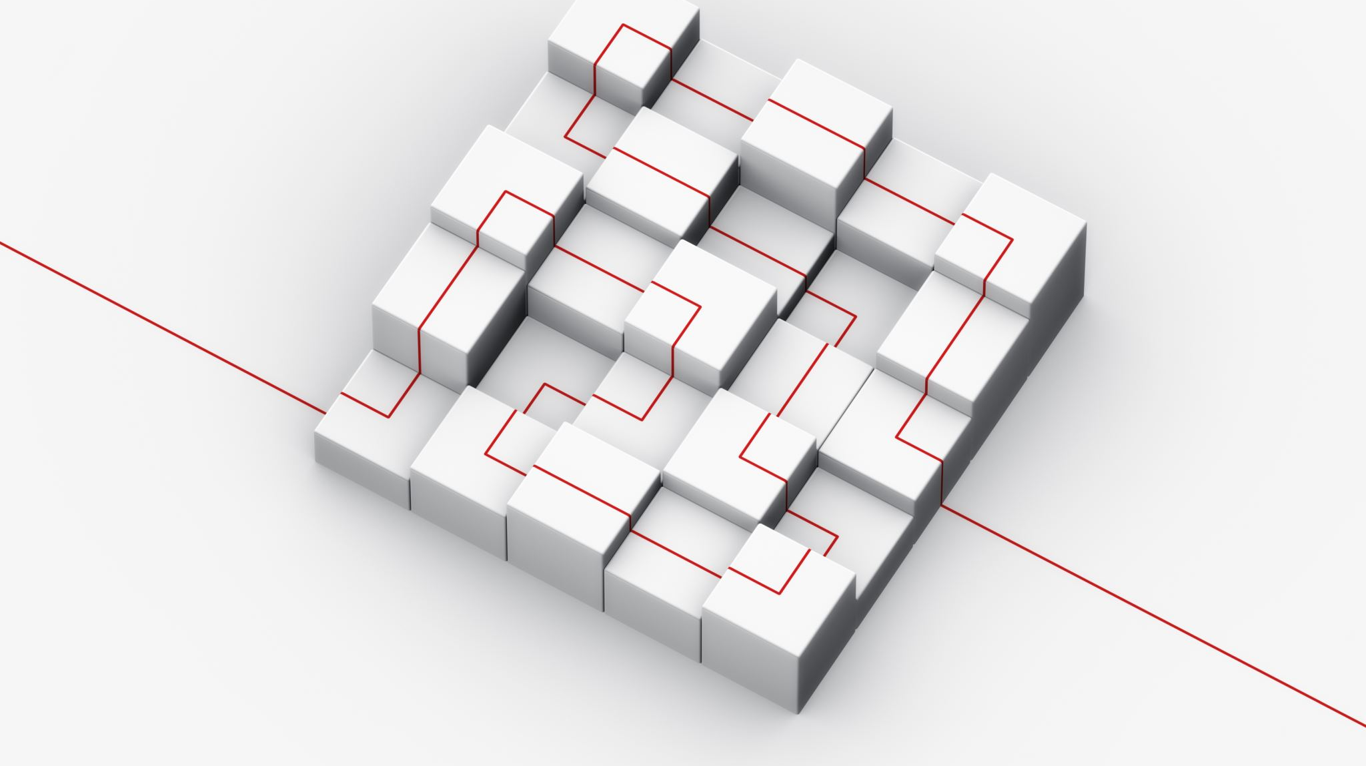
MODELLING
1. Introduction to Modelling
Importance of modeling in web development.
Helps structure and plan the project.
2. Design Frameworks
Responsive Design: Ensures usability on all devices.
Colours : Enhances visual appeal.
3. Development Methodologies
Development: Iterative process with regular feedback.
4. JavaScript Enhancements
Smooth Scrolling and Animations: For better user experience.
Dynamic Content: JavaScript for interactive features.
5. CSS Techniques
Tables Formats : Responsive and adaptable layouts.
Styling: Consistent theme with CSS variables.

Slide 9
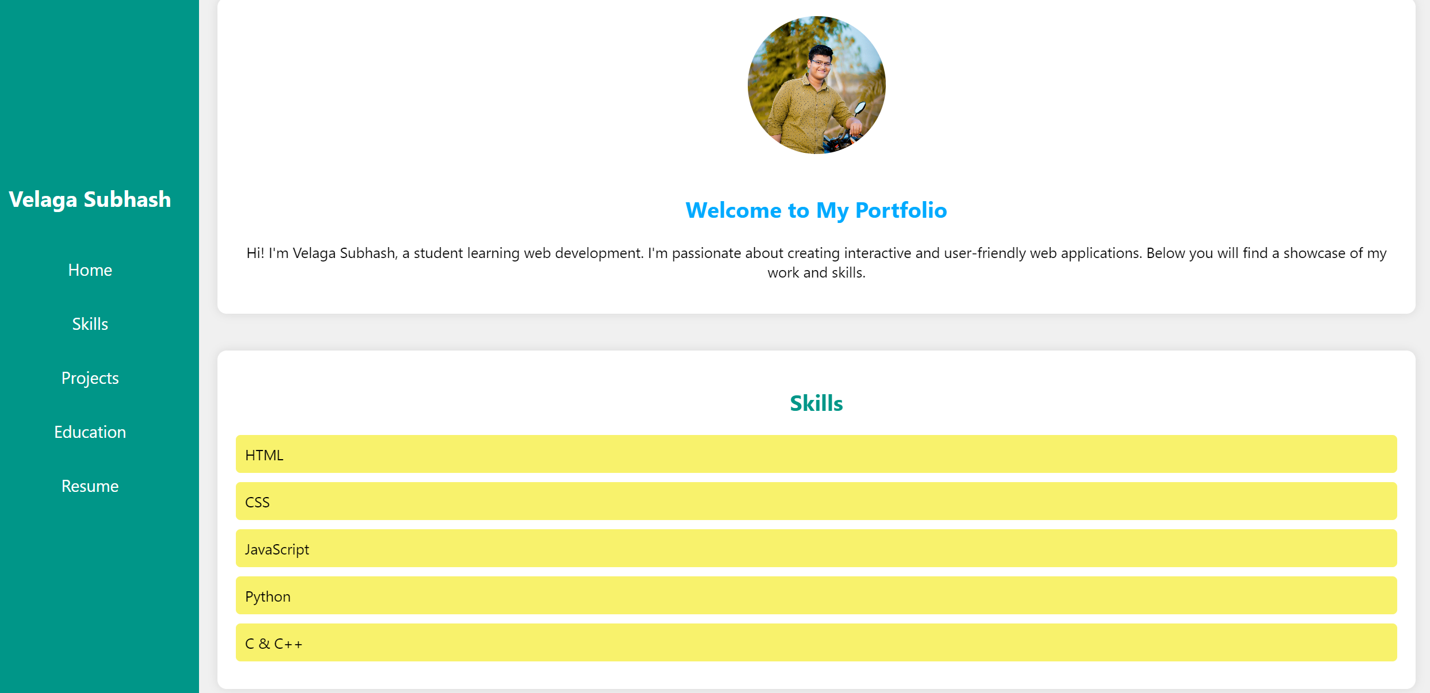
RESULT

Slide 10
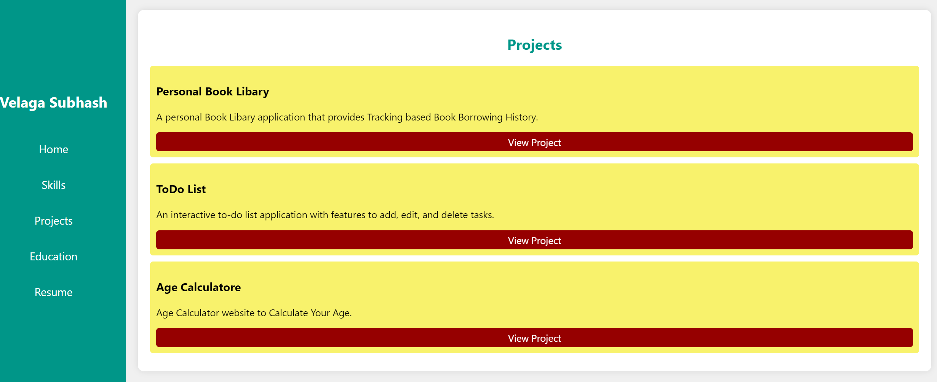

Slide 11
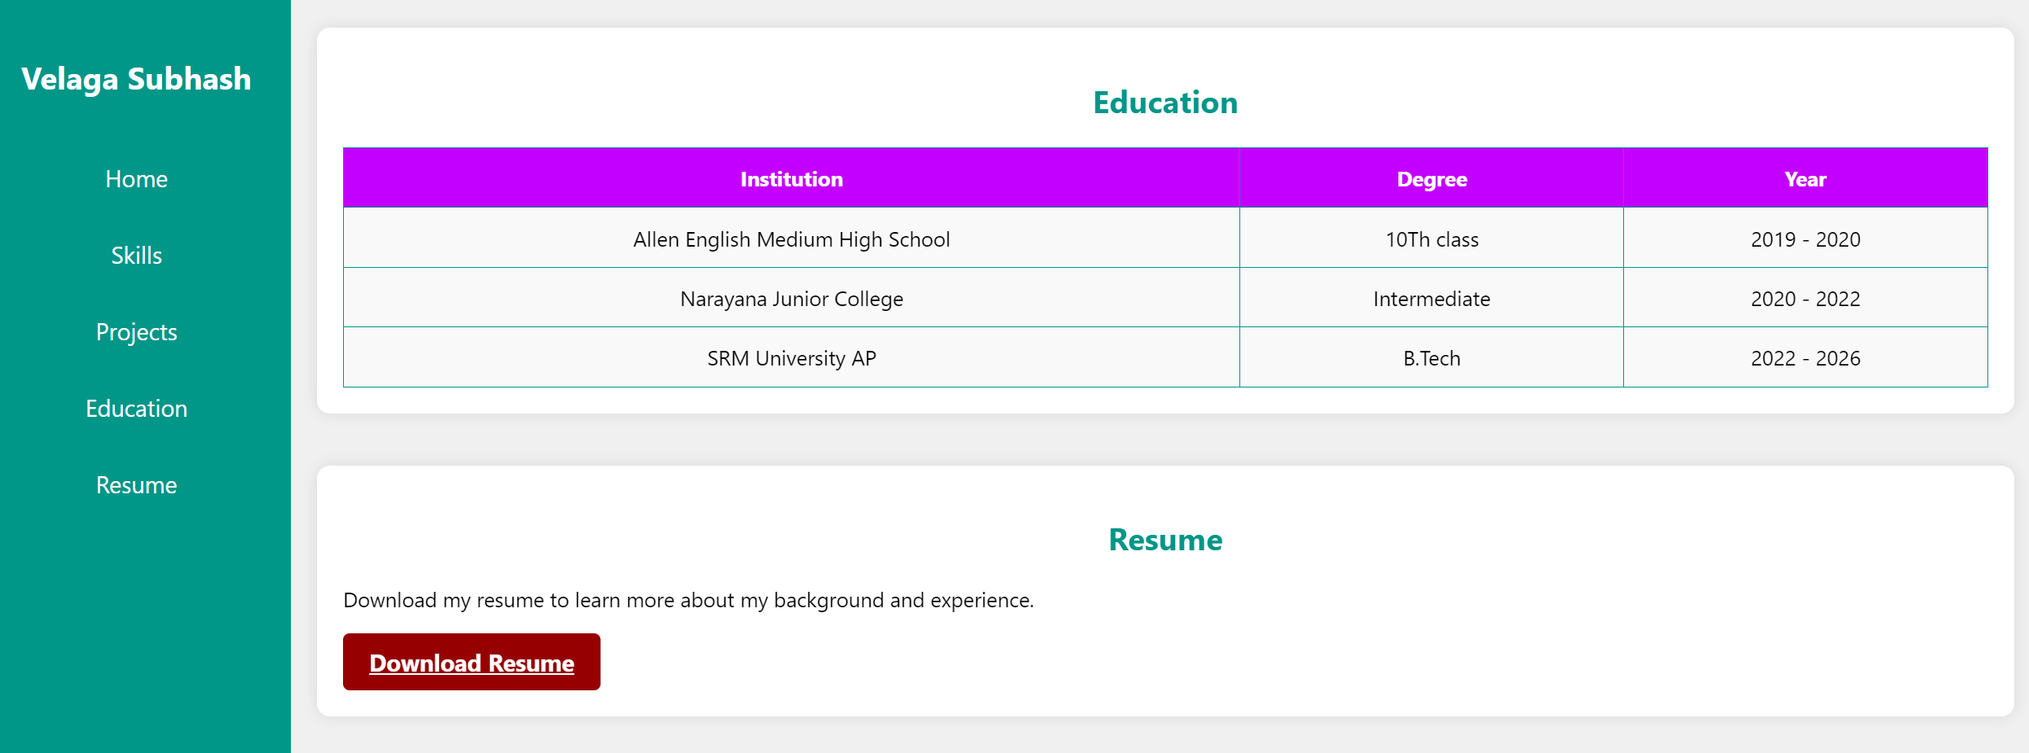

Slide 12

LINKS
https://github.com/VELAGASUBHASH/Edunet_Project

